Slide 1
AERON COMPOSITE LIMITED
Advanced Composite solutions
For sustainable future
Investor Presentation
November 2024

Slide 2
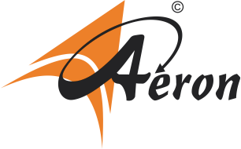
Table of Content
Business Overview & Financials
4-18
01
Strategic Updates
19-26
02
Performance Snapshot
26-30
03
Annexures
31-35
03

Slide 3
Disclaimer
This presentation has been prepared by and is the sole responsibility of Aeron Composite Limited. By accessing this presentation, you are agreeing to be bound by the trailing restrictions.​
This presentation does not constitute or form part of any offer or invitation or inducement to sell or issue, or any solicitation of any offer or recommendation to purchase or subscribe for, any securities of the Company, nor shall it or any part of it or the fact of its distribution form the basis of, or be relied on in connection with, any contract or commitment thereof. In particular, this presentation is not intended to be a prospectus or offer document under the applicable laws of any jurisdiction, including India. No representation or warranty, express or implied, is made as to, and no reliance should be placed on, the fairness, accuracy, completeness or correctness of the information or opinions contained in this presentation. Such information and opinions are in all events not current after the date of this presentation. ​
Certain statements in this presentation describing the Company’s objectives, projections, estimates, expectations or predictions may constitute “forward looking statements”. Such statements are based on the current expectations and certain assumptions of the Company's Management, and are, therefore, subject to risks, uncertainties and other factors that may cause actual results to differ materially from those expressed or implied. ​
This presentation is for general information purposes only, without regard to any specific objectives, financial situations or informational needs of any particular person. The Company neither intends, nor assumes any obligation to amend, modify, revise or update this communication including the forward-looking statements, on the basis of any subsequent developments which differ from those anticipated. The Company may alter, modify or otherwise change in any manner the content of this presentation, without obligation to notify any person of such change or changes.​

Slide 4
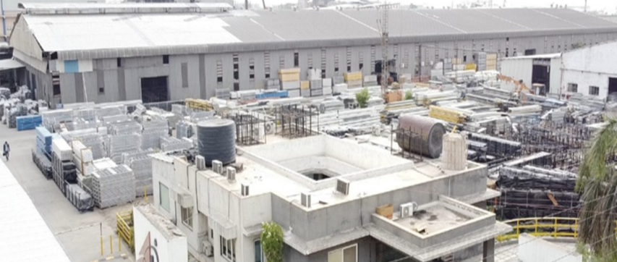
Business Overview & Financials
https://www.aeroncomposite.com

Slide 5
Aeron - Leading the Future of Composite Solutions
Business Summary
Financial Highlights (During the FY 2023-24)
Established in 2011, manufactures and supplies Fiber Glass Reinforced Polymer (FRP) products
Rs 200 Cr
Rs 15.5 Cr
Rs 10.1 Cr
Revenue
EBITDA
PAT
The range of FRP products includes Pultruded Products, Moulded Gratings, and Rods
7.8%
33.2%
32.2%
Product advantage includes corrosion and chemical resistance, high strength, lightweight and ease of application
ROE
ROCE
EBITDA Margin
Operational Highlights
The company provides comprehensive solutions encompassing design, prototype development, testing, manufacturing, logistics, installation, and after-sales service
11
18,845 MT
450+
Products
Installed Capacity
Team Size
ISO 9001:2015 certified manufacturing facility with in-house R&D unit registered with the Department of Scientific & Industrial Research
30 Countries
26,320 Sq. mtr
800
“Two Star Export House” recognition under the Foreign Trade Policy 2023
Exports
Manufacturing Unit Area
Customers across Globe
https://www.aeroncomposite.com

Slide 6
FRP (Fiber-reinforced polymer)
Providing long lasting and
new age ‘GREEN’ solution to aging Infrastructure
https://www.aeroncomposite.com

Slide 7
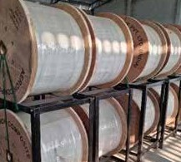
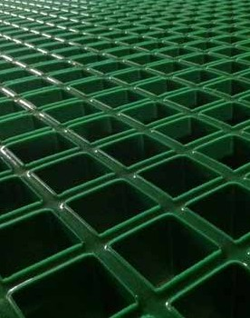
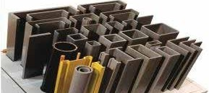
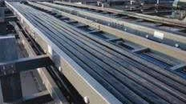
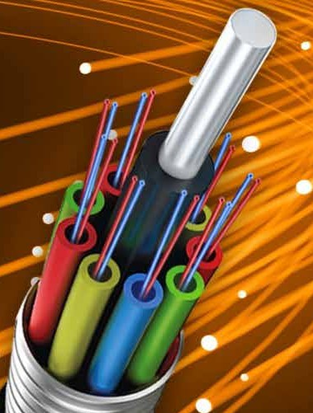
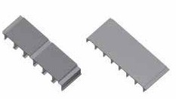
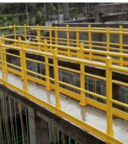
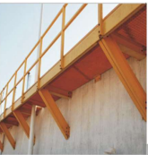
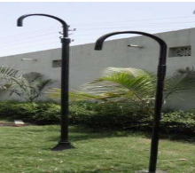
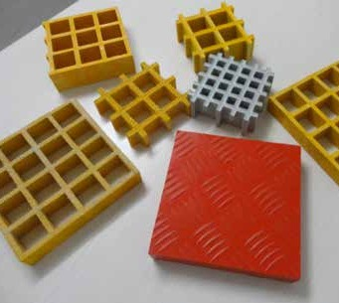
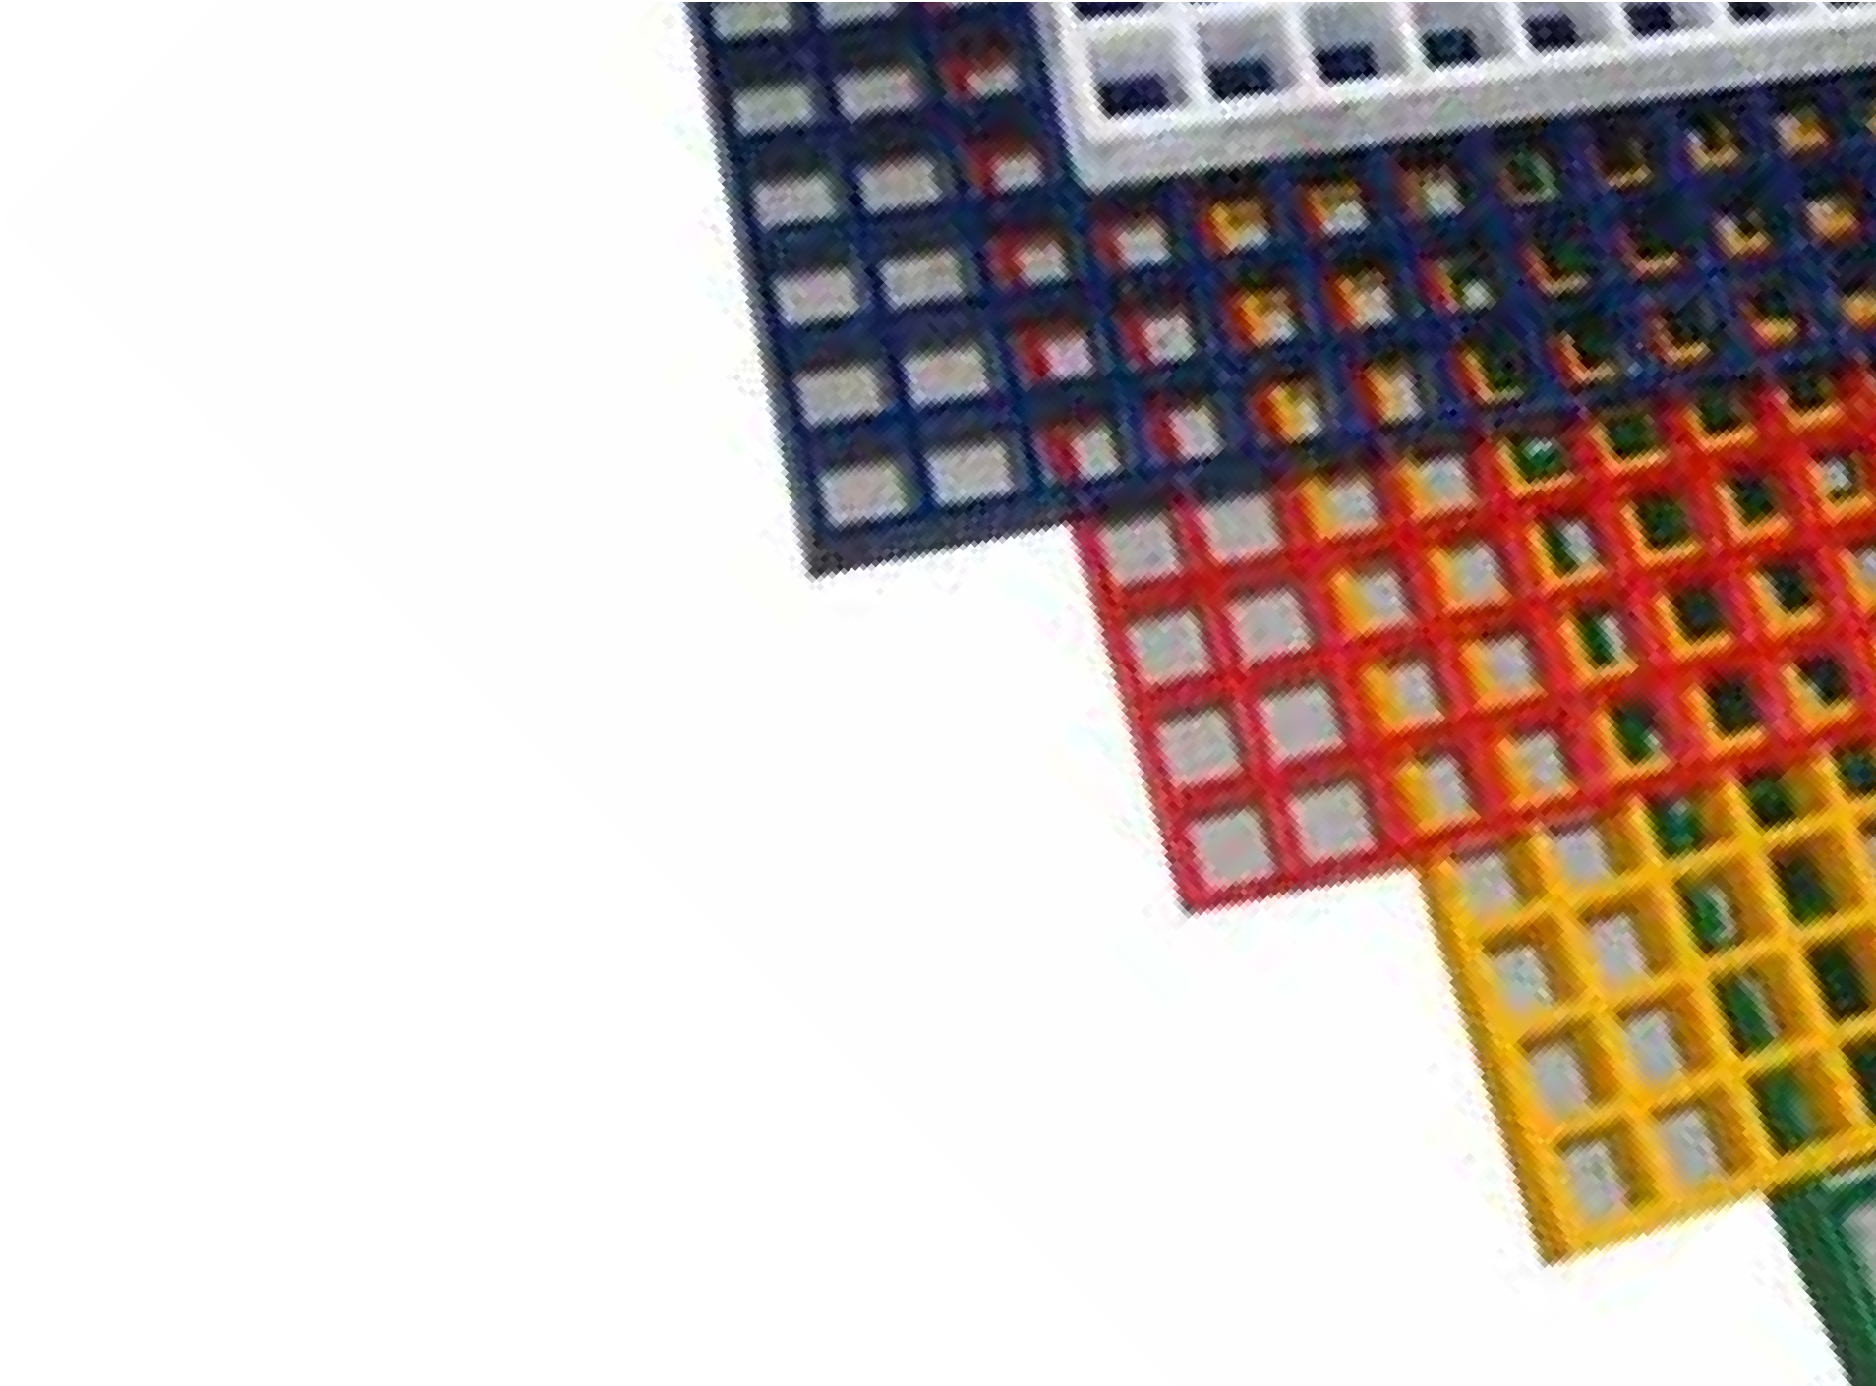
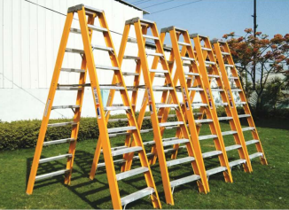
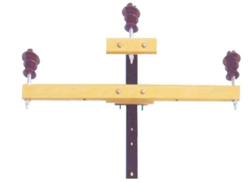
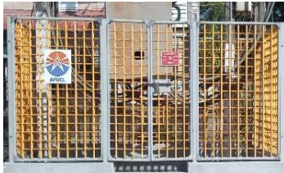
Pioneering Excellence: Among India's largest composite providers
FIBER GLASS REINFORCED POLYMER PULTRUDED PRODUCTS
FRP Rods
FRP Moulded Gratings
Applications: In industrial structures, utility poles, railway structures, chemical processing plants, and safety equipment due to their high strength-to-weight ratio, corrosion resistance, and durability, offering advantages over steel and other metals
Applications
Provides support and protection to delicate optical fibers in optic fiber cables
Benefits
Lightweight, Non-magnetic, Corrosion-resistant
Applications - Flooring, walkways, and platforms in industrial and commercial settings
Features - Bi-directional strength, High chemical resistance
Advantages - Ensures optimal perfor- mance, safety, and durabili- ty, making them a smart investment for any project.
FRP/GRP Structural
Profiles
FRP/GRP Cable Tray
Features
Minimal impact on cable weight
Reduces electromagnetic interference
Advantages
Essential for maintaining the structural integrity and performance of optic fiber networks
FRP Deck
FRP Handrails
FRP Poles
Benefits
Safe, Durable, Corrosion-resistant
FRP Ladder
FRP Cross Arm
FRP Fencing
https://www.aeroncomposite.com

Slide 8
Advantages of FRP/GRP/Fiberglass
Corrosion/Chemical Resistance
High Strength
Light Weight
Electrical Non Conductivity
Thermal Non Conductivity
EMI/RFI Transparent
Ease of Fabrication
Low Life Cycle Cost
Less Environmental Impact
Termite Proof
Flame Retardant

Slide 9
Comparison with Conventional materials
 | Aeron FRP | Steel | Aluminium | Timber
Corrosion Resistance | High | Low | Medium | Low
Strength | High | High | High | Low
Weight | Low | High | Low | Medium
Electrical Conductivity | Low | High | High | Moderate
Thermal Conductivity | Very Low | High | High | Low
EMI/RFI Transparency | Yes | No | No | Yes
Fabrication | Easy | Easy | Moderate | Easy
Life Cycle Cost | Low | Moderate | Moderate | High
Environmental Impact | Low | High | High | Low

Slide 10
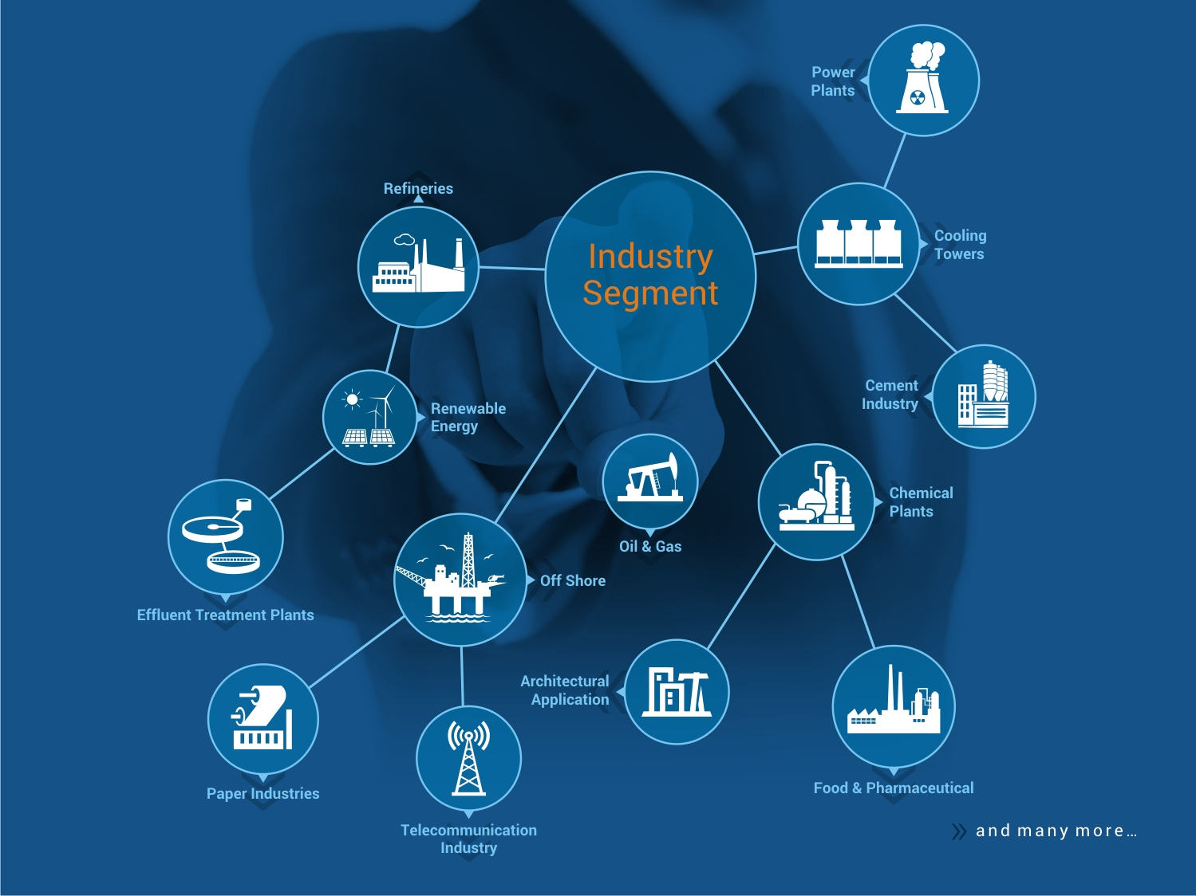
Leading to Diverse Application Portfolio
Aeron Composite Ltd. boasts a diverse application portfolio, serving a wide range of industries including telecommunications, oil & gas, and renewable energy. The company's ability to tailor its FRP solutions to specific industry requirements demonstrates its versatility and expertise. This diverse application portfolio positions Aeron as a preferred partner for clients seeking customized and reliable FRP products

Slide 11
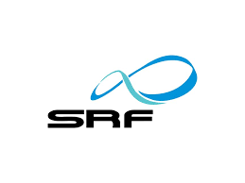
Serving international and domestic clients

Slide 12
Strong Industry tailwinds
India's composite sector is experiencing rapid growth, positioning the country favorably in the global market
CAGR 8.10%
CAGR 16.3%
Source: MRFR Database and Analyst Review
Source: DRHP of the Company
By 2027, India's composite material consumption is projected to reach 768,200 tonnes due to superior performance characteristics.
Asia Pacific, led by India and China, is expected to dominate global composite material demand, supported by favourable FDI policies and government regulations.

Slide 13
Creating superiors shareholder value (1/2)
Revenue
EBITDA
Profit after Tax
Export vs Domestic
Net Profit Ratio
ROCE
(In ₹Cr except percentages and ratios)

Slide 14
Creating superiors shareholder value (2/2)
Working Capital Days
Net Debt Ratios

Slide 15
Strengthening balance sheet
Debt Equity Ratio

Slide 16
Maintaining strong Margins

Slide 17
Competitive Advantages
Diversified Market, Revenue from various countries across the Globe
Diverse range of Fiber Glass Reinforce Polymer Products
Branding and
promotional activities
Aeron’s diversified global presence, with significant revenue from top countries like India, USA, Australia, UK, and Qatar, strengthens their market position and mitigates domestic risks
Aeron manufactures a diverse range of durable, low-maintenance FRP products for industries such as telecommunications, oil & gas, refineries, renewable energy, and chemicals
Aeron’s increased branding and promotional efforts, including participation in national events and trade portals, have enhanced their visibility in the FRP products industry
Consistent focus on quality
Experienced Senior Management
Aeron’s commitment to quality, ensured by a dedicated team and ISO 9001:2015 accreditation, drives consumer satisfaction and long-term brand loyalty
Experienced promoters bring a combined expertise of 80+ years in the industry, driving growth and strategic development

Slide 18
Strategic priorities
01
02
03
04
Continue to strengthen our existing product portfolio and diversify into new product lines
Setup of new integrated manufacturing unit
Augmenting growth in domestic and global markets
Continue to invest in R&D capabilities
Currently in the process of setting up a new manufacturing unit in Mehsana district of Gujarat, measuring 51,671 sq. mtr, which is owned by the company
Market products to 30+ countries and gradually intend to expand business operations to other counties across the world
Dedicated team of 15 Employees in Research & Development department and further as part of their strategy, Aeron intend to enrich its R&D unit for existing and new line of products at the proposed unit
Product portfolio consists of various FRP products and Aeron is stepping into manufacturing of FRP Rebar and Carbon Fibre Product also, thereby expanding their existing product base to achieve the growth in its business

Slide 19
Aeron – USPs and Strategic Priorities

Slide 20
Aeron - Integrated Business Model
Vertically Integrated
Customer Centric Approach
Sustainability and Longevity Focus
Strong Technical Expertise
Integrated Quality Control
You can edit this text
FRP Rods
Resin
Fully Integrated Manufacturing Plant with State-of-the-Art Technology
FRP Mouldings
Glass Fibers
FRP Gratings
FRP Rebar
Efficient Process with <1% waste
High performance products
Diverse Product Portfolio

Slide 21
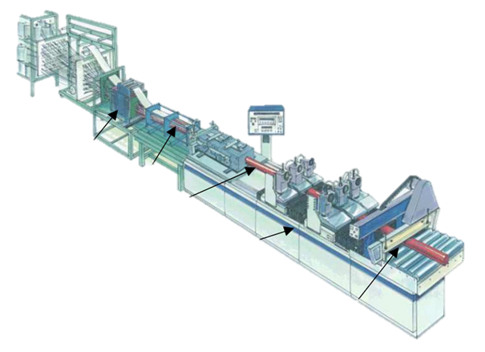
excels in production of FRP Products
Raw Materials
Pultrusion Process
Resin System
Polyester
Vinyl Ester (VE)
Epoxy (EP)
Glass Fibres
Other Additives
Mat Support Framework
Heated Pultrusion Die
Fibre Infeed formation and impregnation
Main Control Pendant
Roving Creel Stand
Twin reciprocating Puller units
Resin Impregnation
Flying Cut-off Saw
Formed, Impregnated reinforcement
Cured Pultruded Profile
Roll-off table
Precision mechanically driven reciprocating puller units giving constant speed irrespective of pulling force
Wet or Dry Cut Saw
Notes:
Screenshot 2024-07-26 at 11.44.20 AMFRP Manufacturing Leader: Aeron excels in production and distribution of Fiber Reinforced Polymer (FRP) products.
End-to-End Solutions: Provides complete services from design to after-sales support.
Aeron Composite Private Limited is a premier manufacturer and distributor of high-performance Fiber Reinforced Polymer (FRP) composite products. With state-of-the-art facilities and a team of experienced engineers, the company delivers end-to-end solutions from design to after-sales support. Aeron's commitment to innovation and customer satisfaction make it a leader in the composite industry.
EBITDA Margins – 5.48%
PAT Margin – 3.69%
ROCE- 27.52%
Revenue from Operation - 17938.42 ( Rs. lakh)
Aeron Composite’s leadership team, composed of industry veterans with deep expertise in composite materials and strategic management, drives the company’s sustained growth and innovation. Their proven track record in navigating complex market dynamics and their strategic vision ensure Aeron Composite remains at the forefront of the industry, delivering consistent profitability and competitive advantage.
Through strategic alliances with top industry players and research institutions, Aeron Composite enhances its R&D capabilities, fostering continuous technological advancements. These partnerships enable the company to stay ahead of market trends, rapidly adapt to evolving customer needs, and deliver superior products, solidifying its market leadership and innovation prowess.
Aeron Composite sets the benchmark in the industry with its advanced composite materials that deliver exceptional strength, durability, and lightweight properties. By consistently exceeding industry standards, Aeron Composite ensures unmatched reliability and performance for aerospace, automotive, and construction applications, positioning itself as the preferred choice for high-performance solutions.
The burgeoning demand for lightweight, high-performance composite materials across key sectors such as aerospace, automotive, wind energy, and construction provides a robust growth outlook for Aeron Composite. By strategically positioning itself to leverage these strong industry tailwinds, Aeron Composite ensures a sustainable growth trajectory and reinforced market dominance.
Aeron Composite's solid balance sheet, characterized by robust liquidity, low debt levels, and a strong capital structure, provides a foundation of financial resilience. This financial strength enables the company to make strategic investments in R&D, expand capacity, and penetrate new markets, ensuring long-term value creation and the agility to capitalize on emerging growth opportunities.

Slide 22
State of the art Manufacturing Facilities - upgrading
Installed Capacity (in Mt)
Actual Production (in Mt)
Capacity Utilization (in %)
Notes:
Screenshot 2024-07-26 at 11.44.20 AMFRP Manufacturing Leader: Aeron excels in production and distribution of Fiber Reinforced Polymer (FRP) products.
End-to-End Solutions: Provides complete services from design to after-sales support.
Aeron Composite Private Limited is a premier manufacturer and distributor of high-performance Fiber Reinforced Polymer (FRP) composite products. With state-of-the-art facilities and a team of experienced engineers, the company delivers end-to-end solutions from design to after-sales support. Aeron's commitment to innovation and customer satisfaction make it a leader in the composite industry.
EBITDA Margins – 5.48%
PAT Margin – 3.69%
ROCE- 27.52%
Revenue from Operation - 17938.42 ( Rs. lakh)
Aeron Composite’s leadership team, composed of industry veterans with deep expertise in composite materials and strategic management, drives the company’s sustained growth and innovation. Their proven track record in navigating complex market dynamics and their strategic vision ensure Aeron Composite remains at the forefront of the industry, delivering consistent profitability and competitive advantage.
Through strategic alliances with top industry players and research institutions, Aeron Composite enhances its R&D capabilities, fostering continuous technological advancements. These partnerships enable the company to stay ahead of market trends, rapidly adapt to evolving customer needs, and deliver superior products, solidifying its market leadership and innovation prowess.
Aeron Composite sets the benchmark in the industry with its advanced composite materials that deliver exceptional strength, durability, and lightweight properties. By consistently exceeding industry standards, Aeron Composite ensures unmatched reliability and performance for aerospace, automotive, and construction applications, positioning itself as the preferred choice for high-performance solutions.
The burgeoning demand for lightweight, high-performance composite materials across key sectors such as aerospace, automotive, wind energy, and construction provides a robust growth outlook for Aeron Composite. By strategically positioning itself to leverage these strong industry tailwinds, Aeron Composite ensures a sustainable growth trajectory and reinforced market dominance.
Aeron Composite's solid balance sheet, characterized by robust liquidity, low debt levels, and a strong capital structure, provides a foundation of financial resilience. This financial strength enables the company to make strategic investments in R&D, expand capacity, and penetrate new markets, ensuring long-term value creation and the agility to capitalize on emerging growth opportunities.

Slide 23
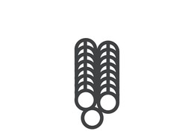
New products Pipeline
The Company’s new product line will be started in this new manufacturing unit
FRP Rebar
Carbon Fiber Products
Timeline-
Product introduced by the end of FY 2025
Product introduced by mid of FY2026
Use Cases-
Approved by material quality check department
Auto/Railways, Custom Parts, Windmills Parts
Advantage-
4x lighter than rebar , Price 140-145/kg (cheaper than steel rebar)
Can increase diameter across pole , High Strength, Corrosion Resistance and Enhanced Performance
Projected CAPEX-
CAPEX of Rs 27 Crores from net proceeds of IPO
[Including Infrastructure]
Notes:
BIS Code provided by client

Slide 24
Competitive products for exports
Revenue from Domestic and Exports (in Cr)
At the close of FY 2024, the company generated approximately 82.7%, 85.8%, 90.7%, and 85.8% of its total revenue from sales in its top five markets: India, USA, Australia, UK, and Qatar over the last 4 years. Currently, the company sells its products in over 30 countries worldwide.

Slide 25
strong future growth
15%+
Key Drivers
Revenue Growth
(3 Years CAGR)
Through strategic alliances with top industry players and research institutions, Aeron Composite enhances its R&D capabilities, fostering continuous technological advancements
The burgeoning demand for lightweight, high-performance composite materials across key sectors such as aerospace, automotive, wind energy, and construction provides a robust growth outlook for Aeron Composite
Aeron Composite's solid balance sheet, characterized by robust liquidity, low debt levels, and a strong capital structure, provides a foundation of financial resilience
The financial strength enables the company to make strategic investments in R&D, expand capacity, and penetrate new markets, ensuring long-term value creation and the agility to capitalize on emerging growth opportunities.
10%+
EBITDA
MARGIN

Slide 26
Performance
Snapshot

Slide 27
Key performance indicators
(In ₹Cr except percentages and ratios)
Key Financial Performance | FY 21 | FY 22 | FY 23 | FY24 | H1FY25
Revenue from operations | 78.8 | 108.3 | 179.4 | 199.7 | 107.9
EBITDA (excluding other income) | 6.1 | 6 | 9.8 | 15.5 | 9.9
EBITDA Margin | 7.8% | 5.5% | 5.5% | 7.8% | 9.2%
PAT | 2.6 | 3.6 | 6.6 | 10.1 | 6.7
PAT Margin | 3.2% | 3.3% | 3.7% | 5.1% | 6.2%
RoE | 23.5% | 26.2% | 32.3% | 33.2% | 10.2%
RoCE | 20.0% | 21.0% | 27.5% | 32.2% | 8%
Net Worth | 12 | 16 | 25 | 35 | 94

Slide 28
PROFIT & LOSS for H1FY25
Particulars | H2FY24 | H1FY24 | H1FY25 | YoY
Revenue from operations | 117.7 | 82.1 | 107.9
Other income | 1 | 0.9 | 2.3
Total Income | 118.7 | 83 | 110.2 | 32.8%
Cost of materials consumed | 71.7 | 57.7 | 66.3
Changes in inventories of finished goods, work-in-progress and stock-in-trade | (1.7) | (7.2) | (3.1)
Employee benefits expense | 10.5 | 8.1 | 8.8
Other expenses | 29.6 | 14.9 | 25.9
EBITDA | 7.4 | 8.1 | 9.9 | 22.3%
Margin | 6.3% | 9.8% | 9.2%
Finance costs | 0.5 | 0.8 | 0.9
Depreciation and amortisation expense | 1.3 | 1 | 1.7
Total Expenditure | 111.8 | 75.4 | 100.5
PBT | 6.9 | 7.6 | 9.6
Net Current Tax Expenses | 1.8 | 2.6 | 2.9
PAT | 5.1 | 5 | 6.7 | 34%
Margin | 4.3% | 6.1% | 6.2%
(In ₹Cr except percentages and ratios)

Slide 29
ASSETS AND LIABILITIES As of h1fy25
Particulars | FY 21 | FY 22 | FY 23 | FY24 | H1FY25
Equity and Liabilities
Shareholders’ funds
a. Share capital | 1.3 | 1.3 | 1.6 | 1.6 | 17
b. Reserves and surplus | 10.8 | 14.3 | 23.8 | 33.9 | 77.3
Non Current liabilities
Long term borrowings | 4.9 | 3.2 | 0.9 | 4.1 | 12.8
Other Non current liabilities | 0.7 | 0.5 | 0.7 | 2.7 | 0.2
Current liabilities
a. Short-term borrowings | 5.6 | 9.3 | 13 | 7.8 | 20.7
b. Trade Payable | 18.0 | 27.7 | 21.7 | 41.3 | 50.4
c. Other current liabilities & provisions | 2.4 | 4.3 | 7.4 | 9.9 | 7.5
TOTAL | 43.7 | 60.6 | 69.1 | 101.3 | 185.9
Particulars | FY 21 | FY 22 | FY 23 | FY24 | H1FY25
Non Current assets
PPE & intangibles | 7.9 | 7.5 | 9.6 | 21.8 | 28.2
Long term loans and advances | 0.9 | 0.5 | 0.0 | 0.5 | 4.7
Other non current assets | 0.9 | 1.6 | 1.7 | 1.4 | 0.5
Current assets
a. Inventories | 11.3 | 21.7 | 19.1 | 25.1 | 36.7
b. Trade receivables | 19 | 20.7 | 31.1 | 41.5 | 48.4
c. Cash and bank balances | 1.5 | 1 | 2 | 5.1 | 54.2
d. Other current assets | 2.2 | 7.6 | 5.6 | 5.9 | 13.2
TOTAL | 43.7 | 60.6 | 69.1 | 101.3 | 185.9
(In ₹Cr)

Slide 30
STATEMENT OF PROFIT & LOSS
Particulars | FY21 | FY22 | FY23 | FY24
Revenue from operations | 78.8 | 108.3 | 179.4 | 199.7
Other income | 0.2 | 1.6 | 2.6 | 2.0
Total Income | 79.1 | 109.9 | 182.0 | 201.7
Cost of materials consumed | 48.4 | 82.0 | 122.1 | 129.4
Changes in inventories of finished goods, work-in-progress and stock-in-trade | 0.9 | (7.3) | 2.8 | (8.8)
Employee benefits expense | 5.8 | 6.7 | 11.5 | 18.6
Other expenses | 17.5 | 20.7 | 32.9 | 44.5
EBITDA | 6.1 | 6 | 9.8 | 15.5
Margin | 7.8% | 5.5% | 5.5% | 7.8%
Finance costs | 1.1 | 1.1 | 1.6 | 1.3
Depreciation and amortisation expense | 1.8 | 1.7 | 1.6 | 2.2
Total Expenditure | 75.4 | 104.9 | 172.4 | 187.2
PBT | 3.6 | 5.0 | 9.6 | 14.5
Net Current Tax Expenses | 1.1 | 1.4 | 2.9 | 4.4
PAT | 2.6 | 3.6 | 6.6 | 10.1
Margin | 3.2% | 3.3% | 3.7% | 5.1%
(In ₹Cr except percentages and ratios)

Slide 31
Annexure

Slide 32
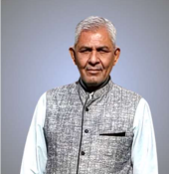
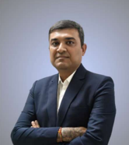
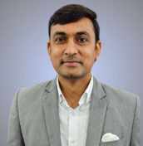
Meet the doers and builders
Dilipkumar Ratilal Patel
Chairman & Non-Executive Director
45+ years of experience, drives strategic planning and oversees Human Resources and CSR, providing essential leadership
Chirag Chandulal Patel
Managing Director
Over 14 years of experience, he oversees production, operations, vendor management, and after-sales services, ensuring seamless business operations
Pankaj Shantilal Dadhaniya
Whole Time Director
MBA graduate with over 27 years of experience, he oversees finance and secretarial functions, offering daily guidance to the team
Ravi Pankajkumar Patel
Whole Time Director
With 13+ years of experience and an MBA from Nirma University, he leads sales, marketing, and business development

Slide 33
Story so far
Started Production of Moulded Gratings Executed first Export order
Moved to new manufacturing unit.
Significant increase in the capacity of Pultrusion and Moulded Grating
IPO: Conversion of the Company from Private Limited to Public Limited Company
- Recognition by Department of Scientific and Industrial Research
- Upgraded to higher status of AEO T2 and in parallel upgraded to Two Star export house recognition
Incorporation of the Company
Started Production of Pultruded Products
Started Production of FRP Rod for Optic Fiber Cables
2011
2012
2015
2019
2020-2023
2024

Slide 34
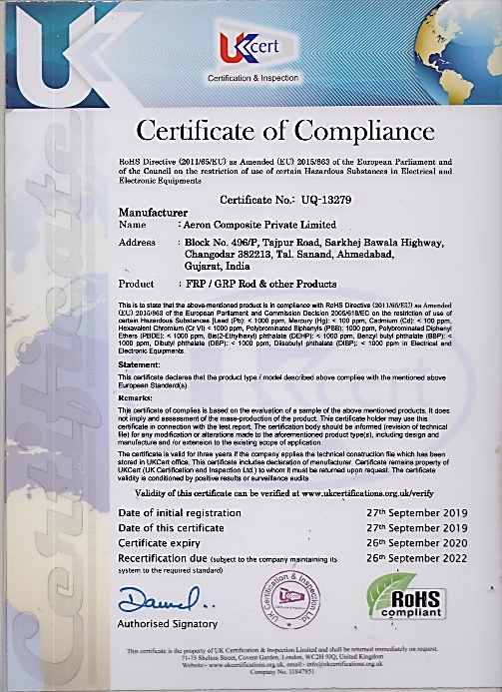
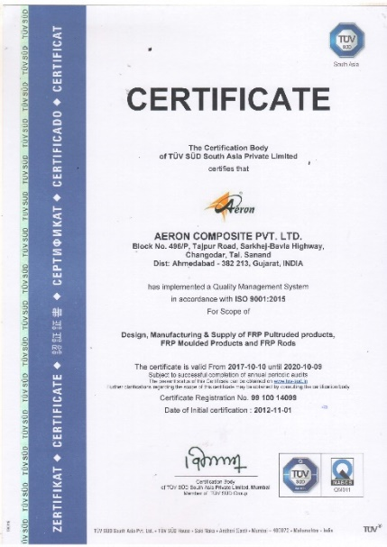
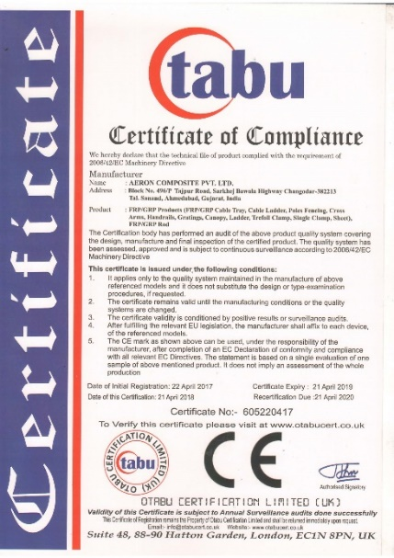
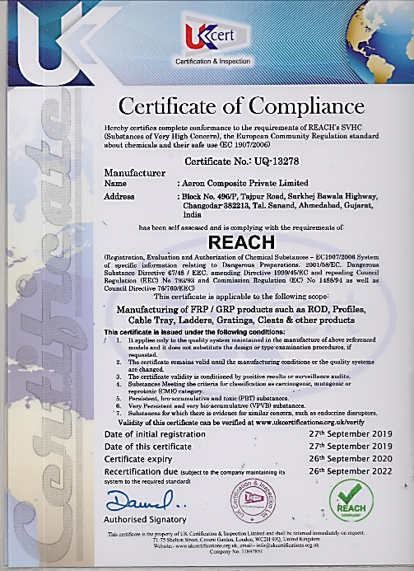
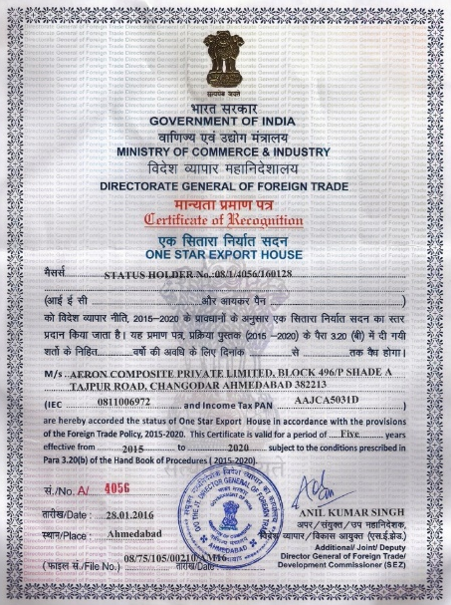
QUALITY & SYSTEM CERTIFICATIONS
GOV. RECO. EXPORT HOUSE
RoHS
ISO 9001:2015
CE
REACH

Slide 35
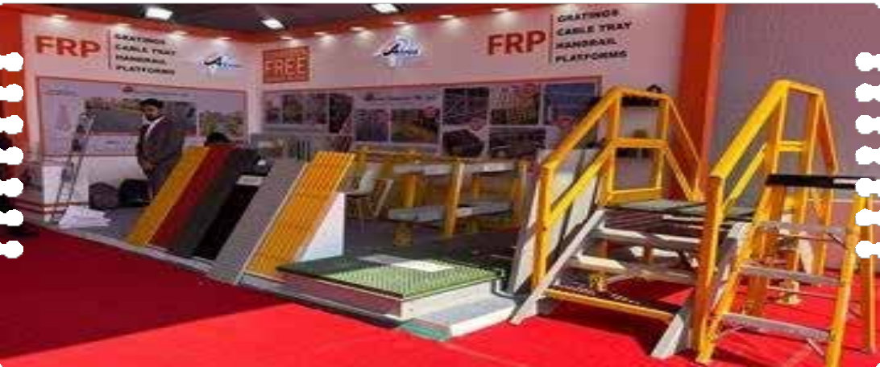
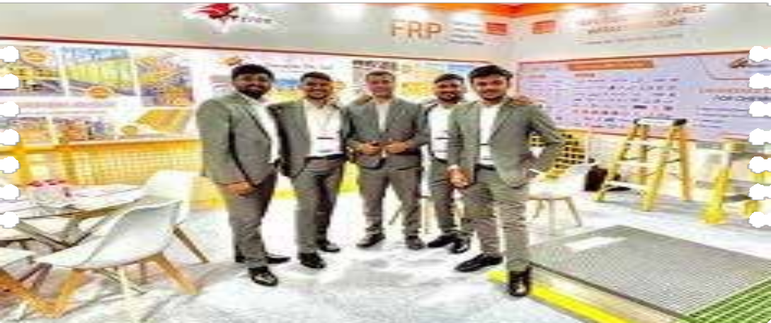
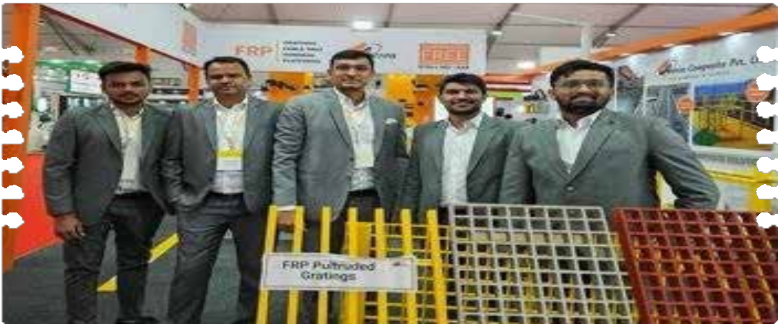
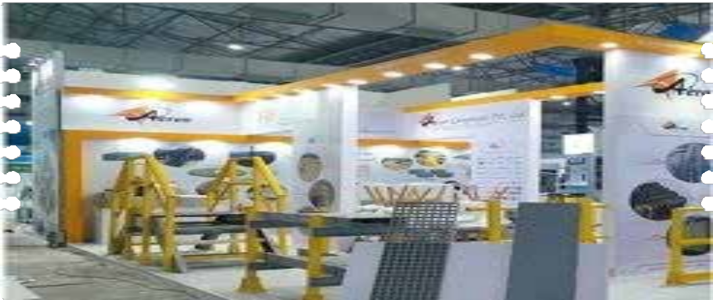
Branding And Promotional Activities
AIA Expo, 2024
ChemTech Mumbai, 2024
Dahej Indusrial Expo, 2023
IFAT Mumbai, 2023
https://www.aeroncomposite.com

Slide 36
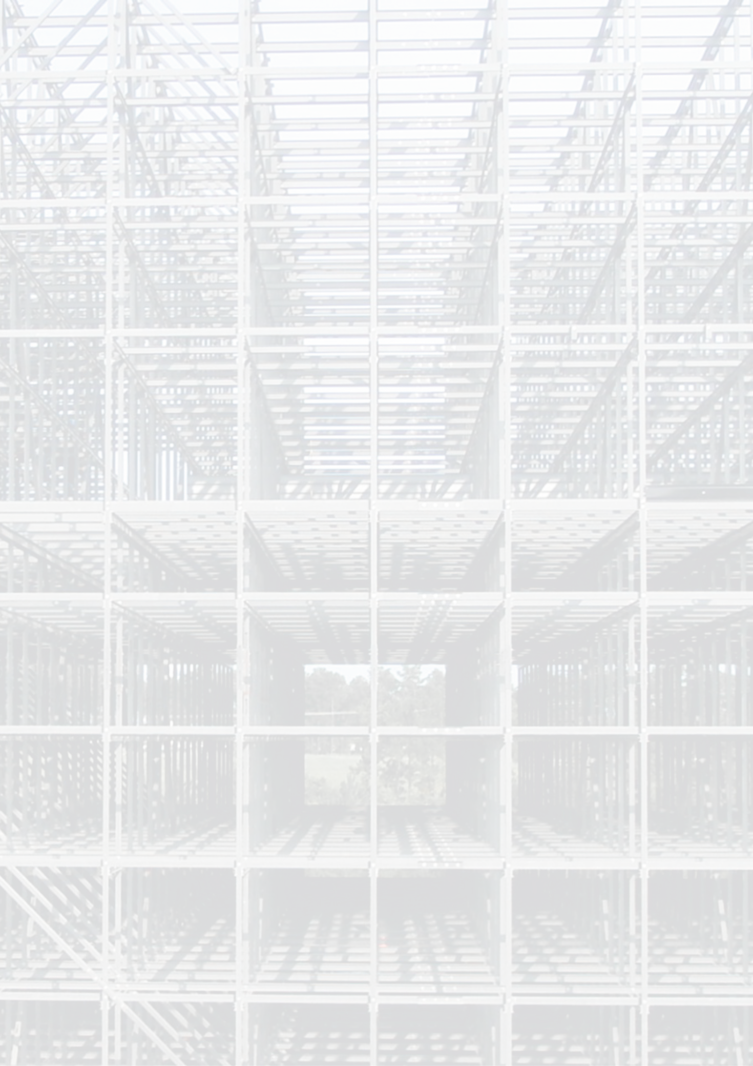
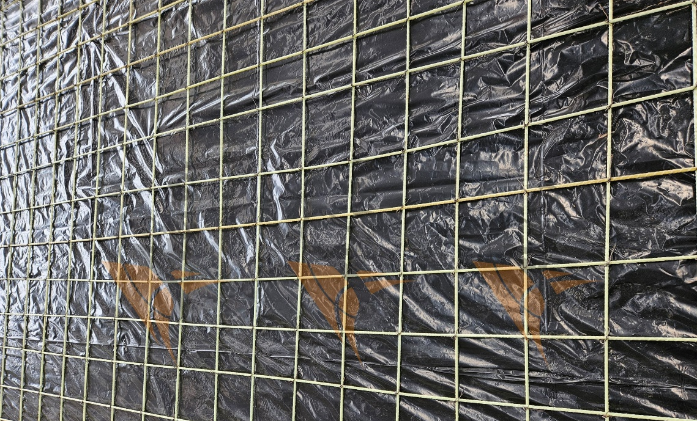
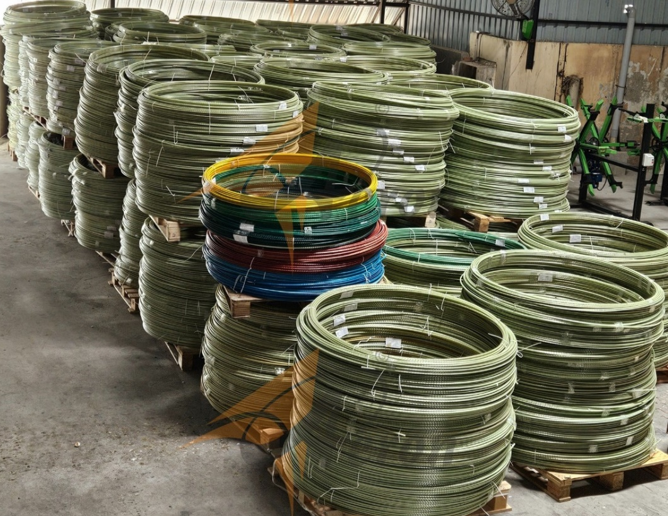
Aeron Composite Limited
Tel: +91-9909988266
Email: cs@aeroncomposite.com
www. aeroncomposite.com
For further information, please contact
Sakshi Katoch
Email: sakshi@goindiaadvisors.com
+91 22 62640831
www.goindiaadvisors.com
https://www.aeroncomposite.com

